Slide 1


B.Tech Computer Science and Engineering – Vth Semester
Theory of Computation
Department of Computer Science and Engineering

Slide 2
Deterministic Push Down Automata
Deterministic Finite Automata – for one input from one particular state there can be only one valid transition.

Slide 3
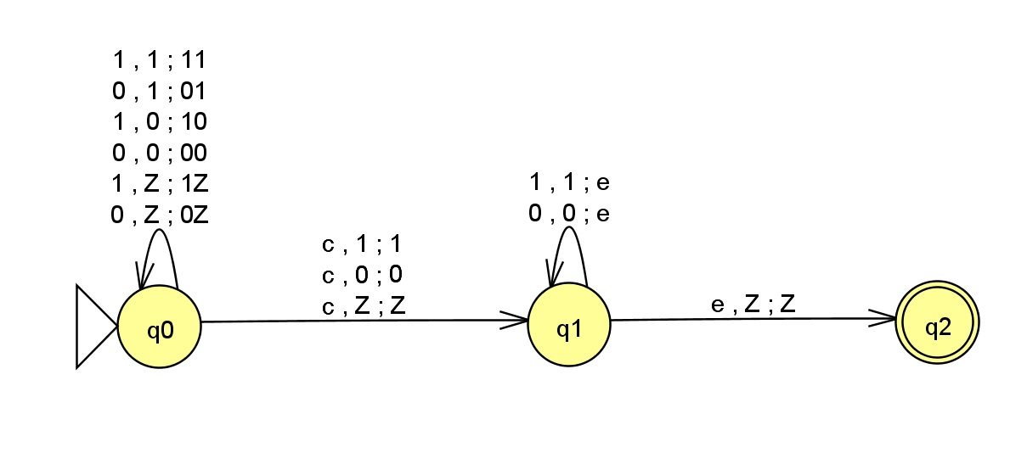
The PDA with the middle marker –WcW^{R}

Slide 4
The PDA with the middle marker –WcW^{R}
Remember: Even if it is a super computer, the input data to be processed need to be in the correct format.
Change the input given to the automata
Sample Strings ={110c011,101c101,01c10….}
Simply we are trying to represent the palindrome WW^{R} as WcW^{R}

Slide 5
The equivalent CFG of a Deterministic PDA is always unambiguous grammar

Slide 6
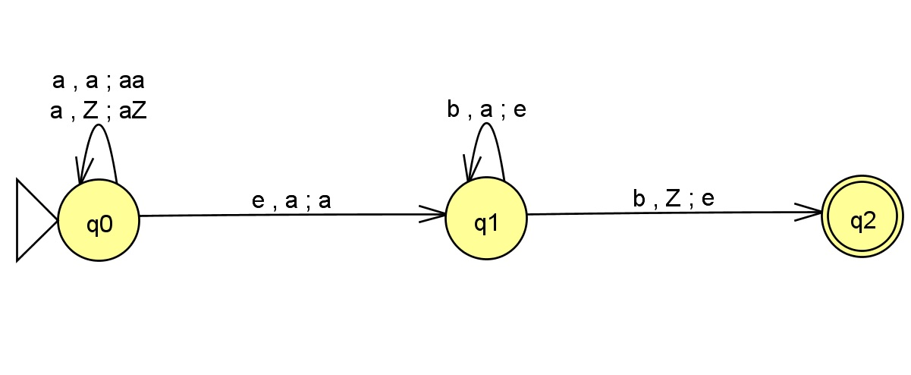

Slide 7
Transitions
aabbbbb |  |  |  | aaabb
Input | Stack | State |  | Input | Stack | State
aabbbbb | Z | q0 |  | aaabb | Z | q0
abbbbb | aZ | q0 |  | aabb | aZ | q0
bbbbb | aaZ | q0 |  | abb | aaZ | q0
bbbb | aaZ | q1 |  | bb | aaaZ | q0
bbb | aZ | q1 |  | bb | aaaZ | q1
bb | Z | q1 |  | b | aaZ | q1
bb | Z | q2 |  | e | aZ | q1
 |  | Accepted |  |  |  | Error

